Slide 1
Overview of Other ML Techniques
Geoff Hulten

Slide 2
There is a lot of machine learning…
Dozens of useful algorithms
Thousands of variations
My advice – build your toolkit starting with:
Something simple and fast (like Logistic Regression)
Modern version of a core machine learning (like GBM or SVM)
Deep Neural Networks
But even that set of tools leaves a lot of ML uncovered

Slide 3
Quick overview of…
Naïve Bayes
Bayesian Networks
Collaborative Filtering
SVMs
Rules

Slide 4
Two Approaches to Supervised Learning
Discriminative
Generative
Model $P(y|x)$ directly
(the posterior probability)
Techniques:
Logistic Regression
Decision Trees
Neural Networks
(Many of the things we studied)
Model $P(x,y)$
(the joint probability)
Use Bayes Rule to get $P(y|x)$
Techniques:
Naive Bayes
Bayesian Networks
Hidden Markov Models
https://ai.stanford.edu/~ang/papers/nips01-discriminativegenerative.pdf

Slide 5
Some Probability Concepts
All Possibilities
P(*) = 1.0
Both Events
$$P\left(A⋀B\right)=.05$$
Conditional Events
$$P\left(B|A\right)=.50$$
Some Event
$$P\left(A\right)=.2$$
Some Event
$$P\left(B\right)=.1$$

Slide 6
Basic Rules of Probability
$$A_{3}= ¬(A_{1}⋁A_{2})$$
Product Rule
Sum Rule
Theorem of Total Probability
A
B
A
B
$$A_{1}$$
$$A_{2}$$
B
Don’t
Double
Count
If $A_{1}, …,A_{n}$are mutually exclusive
and $\sum_{i=1}^{n}{P\left(A_{i}\right)=1}$then:
$$P\left(B\right)=\sum_{i=1}^{n}{P\left(B | A_{i}\right)P(A_{i})}$$
$$P\left(A⋀B\right)= \\ P\left(A | B\right)P\left(B\right)=$$ $P\left(B | A\right)P(A)$
$$P\left(A⋁B\right)= \\ P\left(A\right)+P\left(B\right)− \\ P(A⋀B)$$

Slide 7
Bayes’ Theorem
Bayes’ Theorem
A
B
$$P\left(A⋀B\right)=P\left(A | B\right)P\left(B\right)=P\left(B | A\right)P(A)$$
$$P\left(A | B\right)P\left(B\right)=P\left(B | A\right)P(A)$$
$$P\left(A | B\right)=\frac{P\left(B | A\right)P(A)}{P(B)}$$

Slide 8
Example of using Bayes Theorem
0.008
$$P\left(A | B\right)=\frac{P\left(B | A\right)P(A)}{P(B)}$$
0.992
0.98
0.02
$$P\left(cancer | +\right)=\frac{P\left(+ | cancer\right)P(cancer)}{P(+)}$$
0.03
$$P\left(+ | cancer\right)=0.98$$
0.97
??
$$P\left(cancer\right)=0.008$$
$$P\left(cancer | +\right)=\frac{0.98∗0.008}{P(+)}$$
$$P\left(+ | ¬cancer\right)=0.03$$
$$P\left(cancer | +\right)=\frac{0.98∗0.008}{0.0376}$$
$$P\left(cancer | +\right)=.208$$
$$P\left(+\right)$$
$$P\left(+\right)=P\left(+ | cancer\right)P\left(cancer\right)+P\left(+ | ¬cancer\right)P(¬cancer)$$
$$P\left(+\right)=0.98 ∗0.008 +0.03 ∗ 0.992$$
$$P\left(+\right)=0.0376$$

Slide 9
Naïve Bayes
For each value of $y$:
Record # of times each possible <$x$> occurs in training
Estimate $P\left(<x>\right| y)$ as:
$$\frac{\# times<x> occured}{\# of training samples}$$
Won’t scale…
$$y=\underset{y_{j}∈Y}{argmax}{\frac{P\left(<x>\right|y_{j}) P(y_{j})}{P(<x>)}}$$
$$y=\underset{y_{j}∈Y}{argmax}{P\left(<x>\right|y_{j}) P(y_{j}) }$$
$$y=\underset{y_{j}∈Y}{argmax}{P(y_{j})\prod_{i}{P(x_{i}|y_{j})} }$$
For each value of $y$:
For each value of $x_{i}:$
Record # of times $x_{i}=v$
Estimate $P\left(<x>\right| y)$ as: $\prod_{i}{P(x_{i}=v|y)}$
Independence
Assumption

Slide 10
Naïve Bayes Example
$$y=\underset{y_{j}∈Y}{argmax}{P(y_{j})\prod_{i}{P(x_{i}|y_{j})} }$$
$$y=0$$
$$Training Data$$
$$p(x_{1}=0)$$ | 4/6
$$p(x_{1}=1)$$ | 2/6
$$p(x_{2}=0)$$ | 2/6
$$p(x_{2}=1)$$ | 4/6
$$x_{1}$$ | $$x_{2}$$ | $$y$$
0 | 0 | 0
0 | 1 | 1
0 | 1 | 0
1 | 0 | 1
1 | 1 | 0
1 | 0 | 1
1 | 1 | 0
0 | 0 | 0
0 | 1 | 0
1 | 0 | 1
$$x_{1}$$ | $$x_{2}$$ | $$y$$
0 | 0 | ?
$$y=0$$
$$1 \sim P\left(y=1\right)P\left(x_{1}=0|y=1\right)P(x_{2}=0|y=1)$$
$$y=1$$
$$1 \sim 0.4 ∗ 0.25 ∗ 0.25$$
$$p(x_{1}=0)$$ | 1/4
$$p(x_{1}=1)$$ | 3/4
$$p(x_{2}=0)$$ | 1/4
$$p(x_{2}=1)$$ | 3/4
$$1 \sim .025$$
0 $\sim P\left(y=0\right)P\left(x_{1}=0|y=0\right)P(x_{2}=0|y=0)$
0 $\sim 0.6 ∗ 0.66 ∗ 0.33$
0 $\sim .13$
$$p(y=0)$$ | 6/10
$$p(y=1)$$ | 4/10

Slide 11
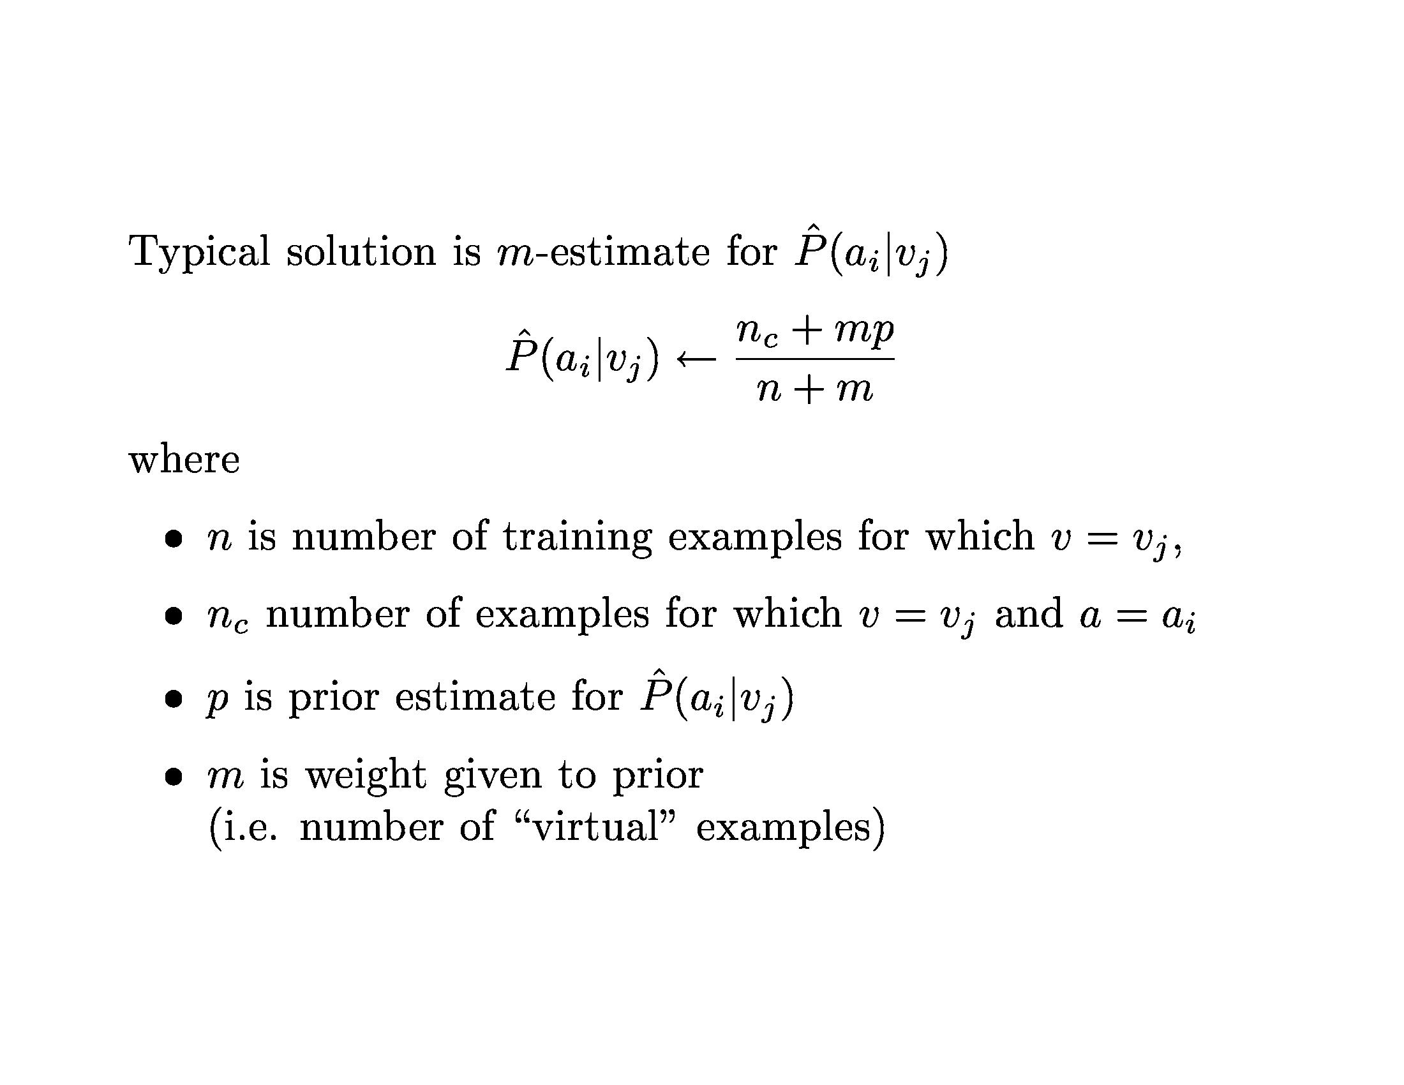

Slide 12
On Being Bayesian

Slide 13
Naïve Bayes Summary
Overview
It is Good For
Structure
A very simple probabilistic model
Loss
Nothing: estimate the parameters from training data
Optimization
None: just count the occurrences in the data
An introduction to
Generative modeling
Bayesian thought
ML in general
In practice
Nothing…
(Maybe as a baseline)

Slide 16
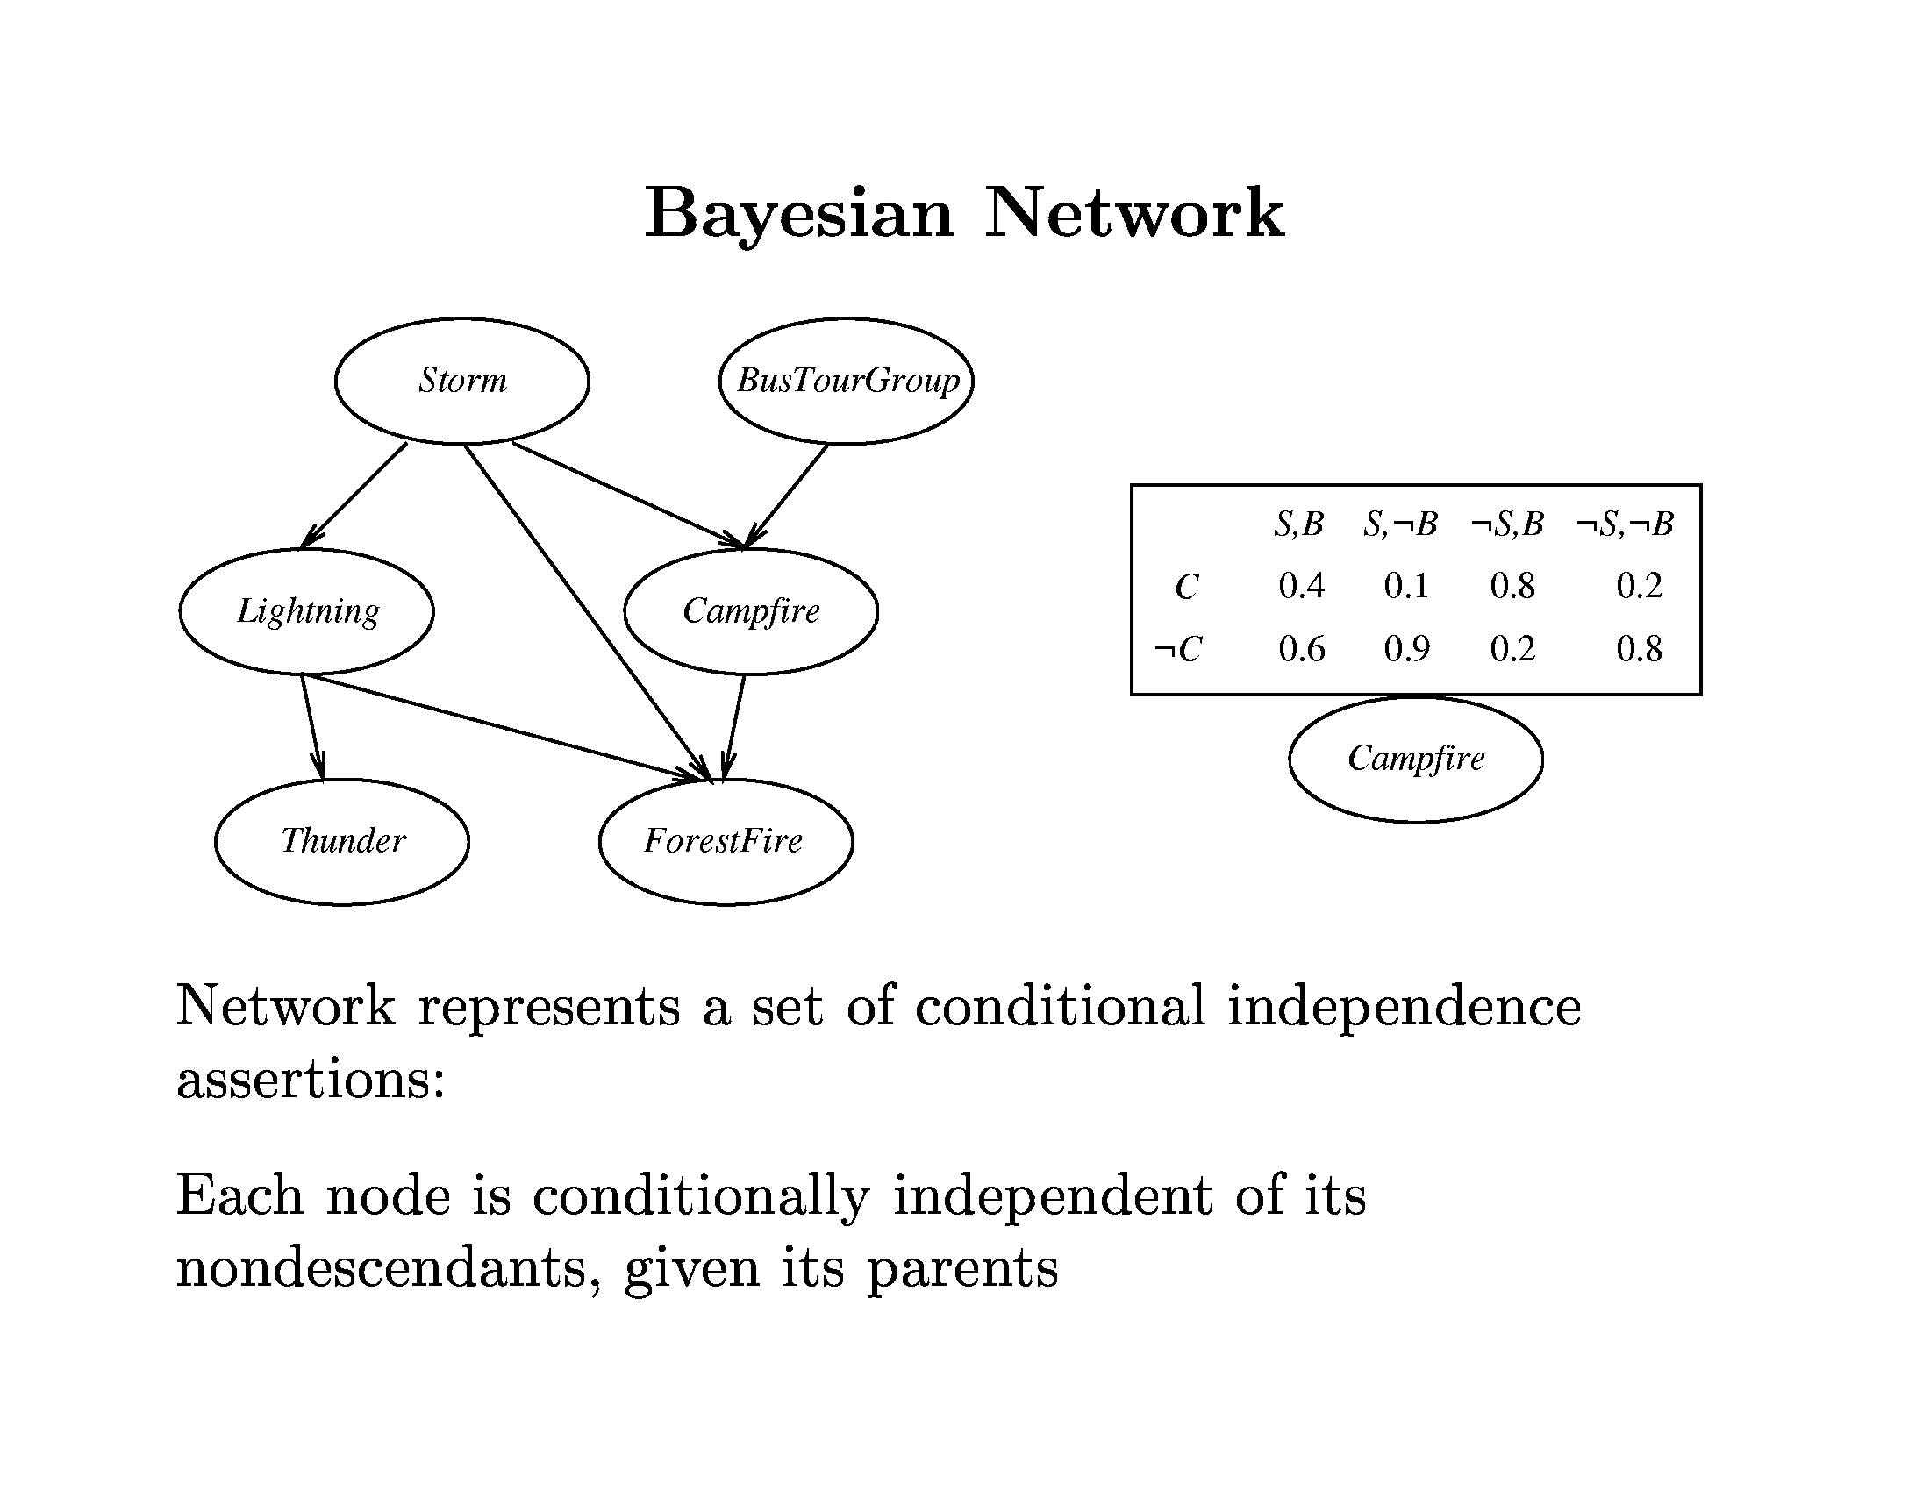

Slide 21
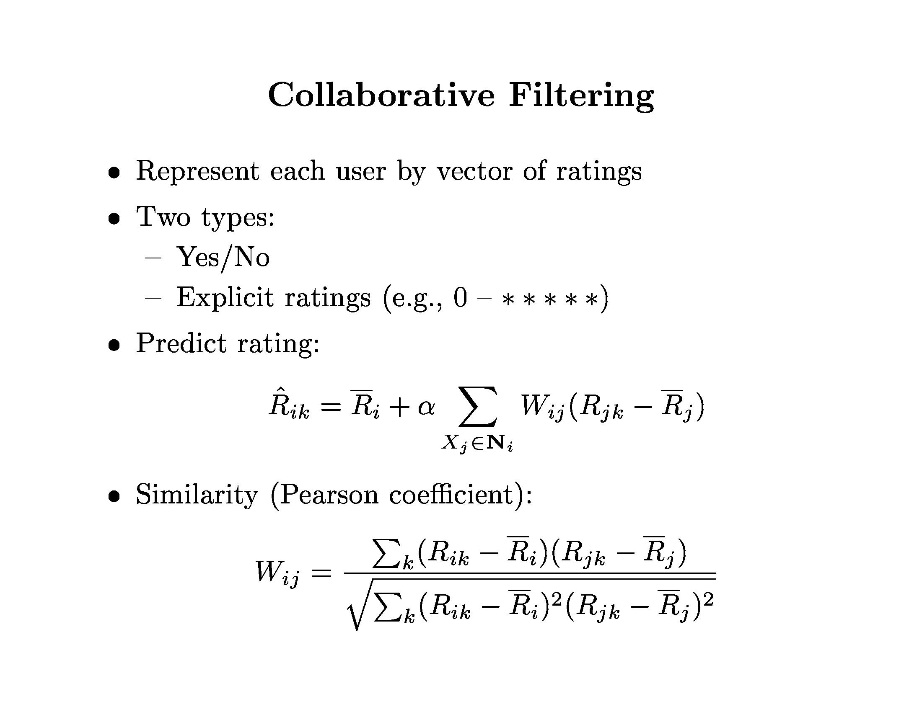

Slide 23
Example of Collaborative Filtering
Will Alice like ${Movie}_{2}$?
$$W_{Alice,Bob} = 1.38$$
$$W_{Alice,Chris} =−1.41$$
$$α=.357$$
$${\hat{R}}_{Alice,2}=3.75+.357(1.38\left(5−3.4\right) −1.41\left(2−2.5\right))$$
$${\hat{R}}_{Alice,2}=3.75+.357(2.22+0.70)$$
$${\hat{R}}_{Alice,2}=3.75+1.04$$
$${\hat{R}}_{Alice,2}=4.79$$

Slide 24
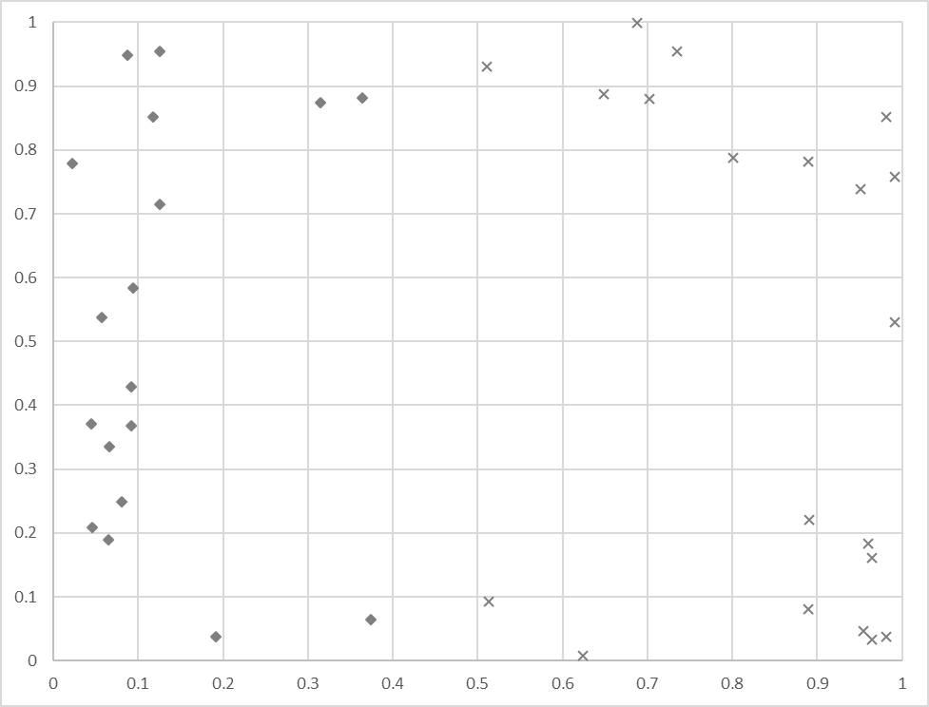
Support Vector Machine (SVM)
Linear separator
$$y^{^}=Sign(w_{0}+ \sum_{i}^{n}{w_{i} ∗ x_{i})}$$
Maximum Margin
Support Vectors

Slide 25
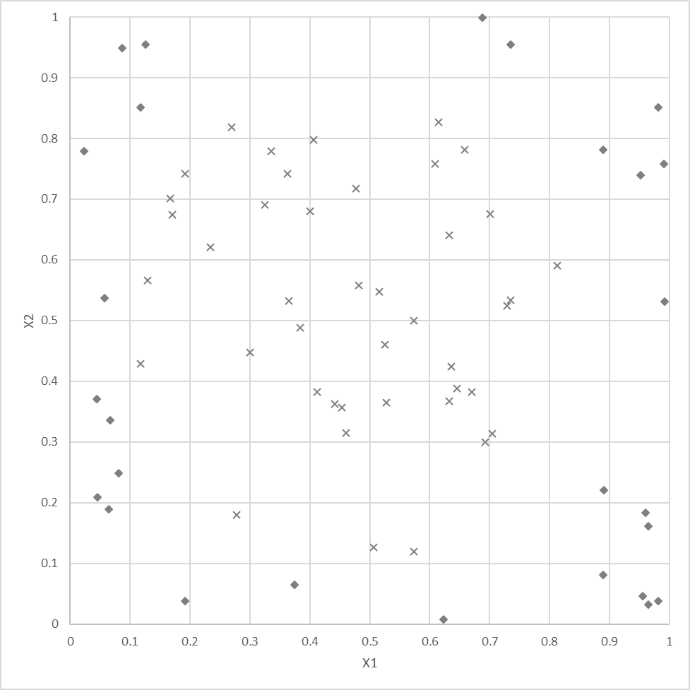
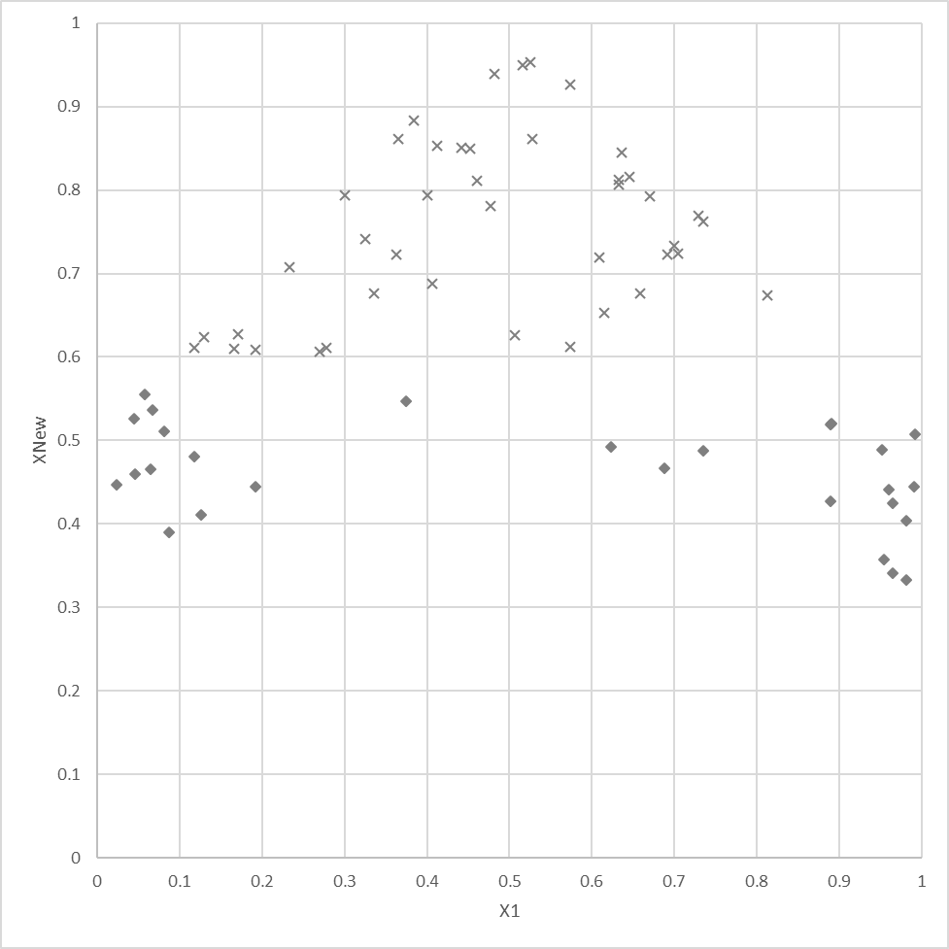
Support Vector Machines For non-linear data
Data not linearly separable
Add a new dimension:
$$x_{new}=1.0 − \sqrt[2]{{(.5−x_{1})}^{2}+{(.5−x_{2})}^{2}}$$
Will be ‘more linearly separable’
Various standard options (kernels)
Try multiple methods
Project back to original space

Slide 26
Support Vector Machines (More Concepts)
Optimization
Solve constrained system of equations
Quadratic programming (e.g. SMO)
Dealing with noise (soft vs hard)

